Slide 1

Automated license plate readers
(ALPR)
program overview

Slide 2






Background
Beginning 2021 - Community meetings to discuss technology
May 18, 2021 – Council approved 45 cameras
2021 - Policy created with guidance from City Attorney’s Office & best practices
September 2021 – 45 cameras installed and operable
September 2023 - Council approved 6 additional cameras and 5-year contract

Slide 3
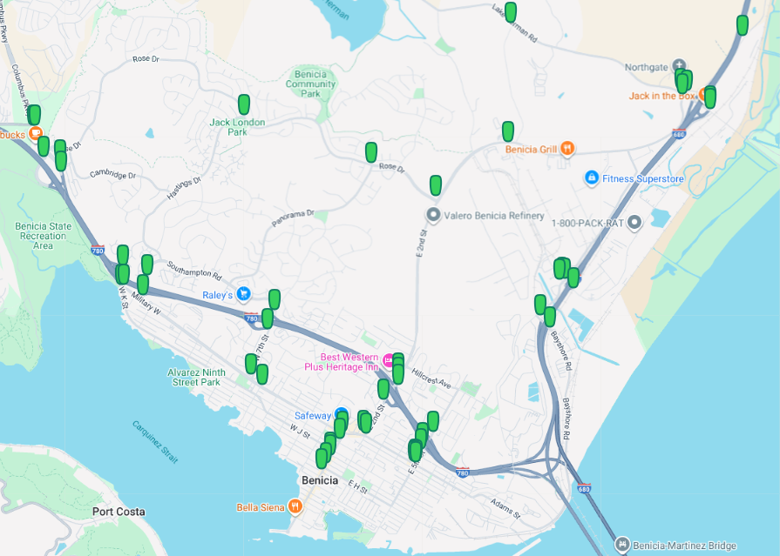
ALPR Locations

Slide 4
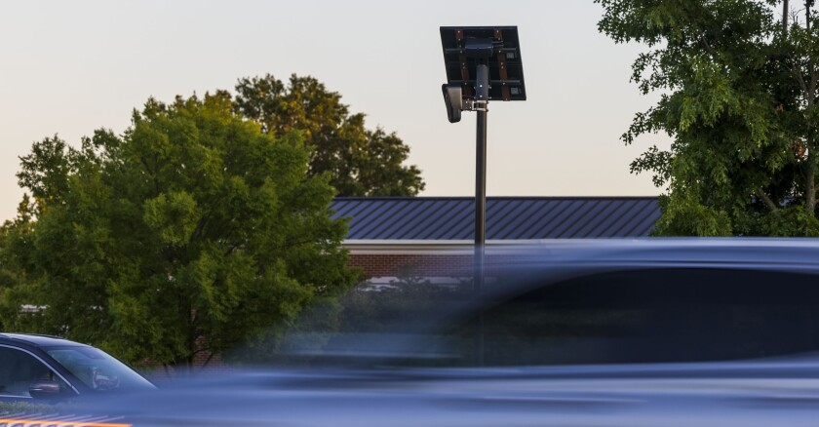
license plate readers
WHAT THEY DO...
WHAT THEY DON’T DO...
License Plate Recognition
Capture vehicle details
Alert Police of wanted vehicles
Used to solve and prevent crime
NO facial recognition
NOT a video recording
NOT use for reproductive health care investigations
NOT for personal research by user
NOT used for immigration enforcement
  SB54 (2017 - Calif. Values Act)
Used by 5,000+ Law Enforcement agencies nationwide

Slide 5

SB 54 - California Values Act
PROHIBITS California Law Enforcement agencies from:
  Using agency resources for immigration enforcement; cannot:
    Investigate
    Interrogate
  Sharing information for purposes of immigration enforcement (including with Border Patrol/ICE)
    Including databases hosted by private vendors (i.e. FLOCK)
Detect
Detain
Arrest

Slide 6

Frequently Expressed concerns
IS THIS A SURVEILLANCE TOOL?
  No. Our ALPR system (FLOCK) is only used to investigate crimes or missing persons.
  It is not used for general patrol or surveillance
  Every inquiry is logged and audit traceable
WHO CAN ACCESS DATA & IS IT SECURE?
  BPD owns all data collected by FLOCK
  We determine who gets access to our data
  All data is encrypted throughout its lifecycle
  Data is purged after 30 days

Slide 7
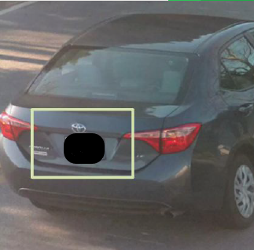
Frequently Expressed concerns
ARE CAMERAS USED TO IDENTIFY PEOPLE?
  No. FLOCK cameras focus on license plates and vehicle details, like:
                Make
                Model
                Color
                Type of plate (temp vs. permanent)
                Damage or alterations to vehicle, i.e. broken taillight, decals, etc

Slide 8
policy
  Law enforcement purposes only
  Individual login and password for users
  All users receive training and must acknowledge policy
  All searches are tracked and recorded
  Internal quarterly audits
  Only share with agencies (Legal/law enforcement) within California. Signed MOU required.

Slide 9

audits
Sampling of the ALPR system to verify proper use
Random selection of at least 10 inquiries
Quarterly, using preceding six-month period
Inquiries meet requirements in policy section 470.6(d)
Documented as internal department memo to Chief of Police
Memo shall include any data errors found
Internal memo to staff to address errors

Slide 10
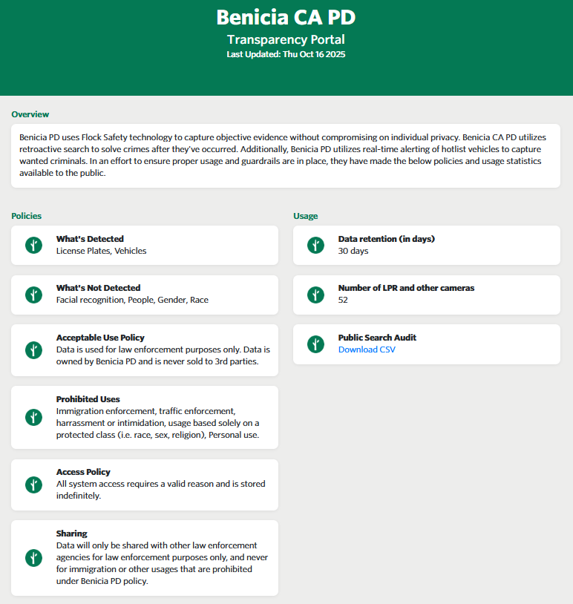
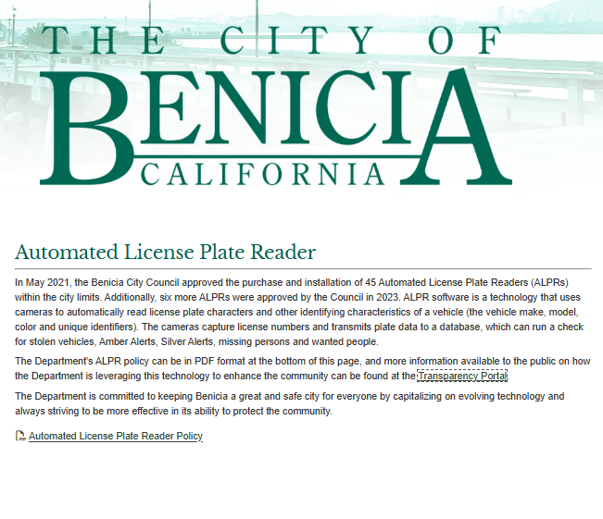
transparency

Slide 11
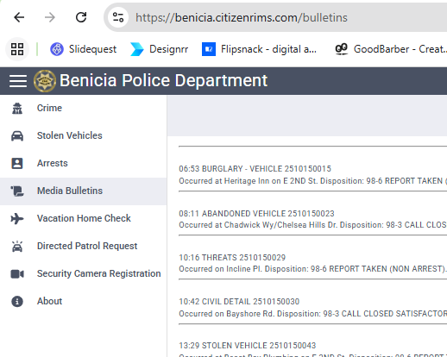
transparency
ALPR/FLOCK public search audit will not match CitizenRims database as ALPR is accessed for investigations/cold cases, in additional to current incidents

Slide 12



Use of alpr
Example incidents/cases that utilize ALPR technology
  Armed Robberies
  Catalytic converter thefts
  Stolen Vehicles
  Homicides
  Property thefts
  Burglaries of Benicia businesses

Slide 13
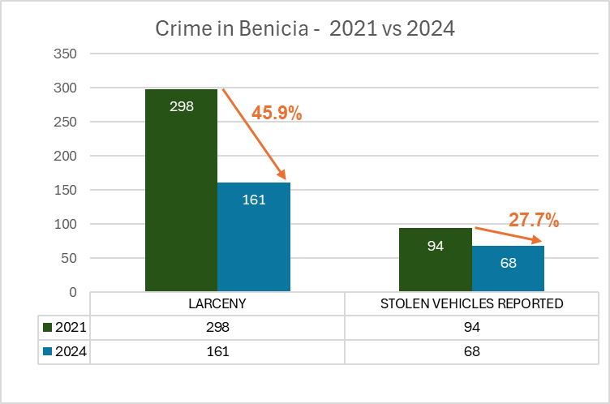
Impact of ALPR on crime
  454 Cases utilizing ALPR
    190 arrests
    27 guns seized
    79 vehicles recovered
    $801,266 - value of recovered property

Slide 14
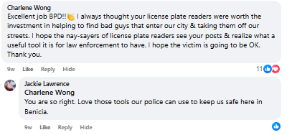
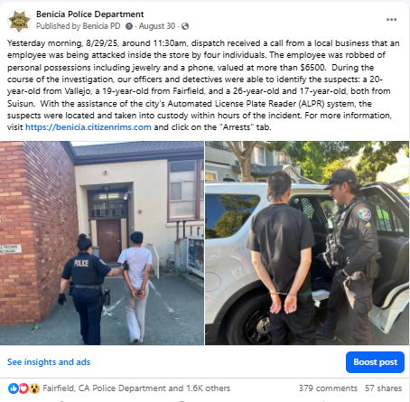


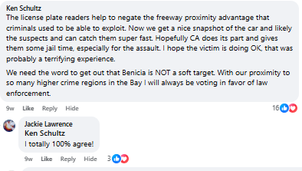




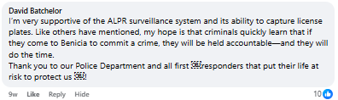



Alpr EXAMPLE

Slide 15



Selection of success stories
  1500 East 5th
  Rose Market
  Safeway employee robbery
  Averted bank robbery
  Copper theft

Slide 16
Questions?

